Slide 1
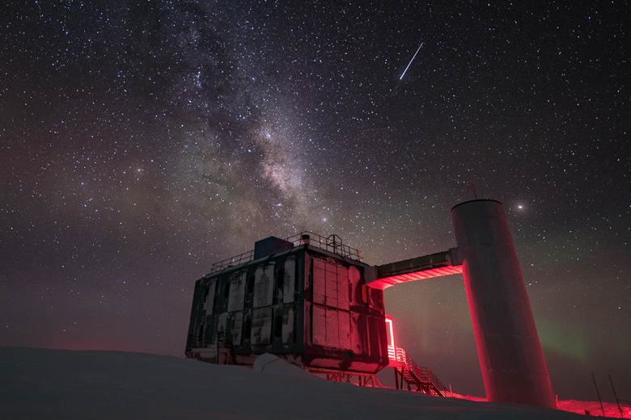
The IceCube Neutrino Observatory: The Perfect Muon Detector Unraveling Cosmic Secrets
Pascal Gutjahr
TU Dortmund University
pascal.gutjahr@tu-dortmund.de
LPC – Clermont-Ferrand
06.10.2023
icecube..wisc.edu

Slide 2
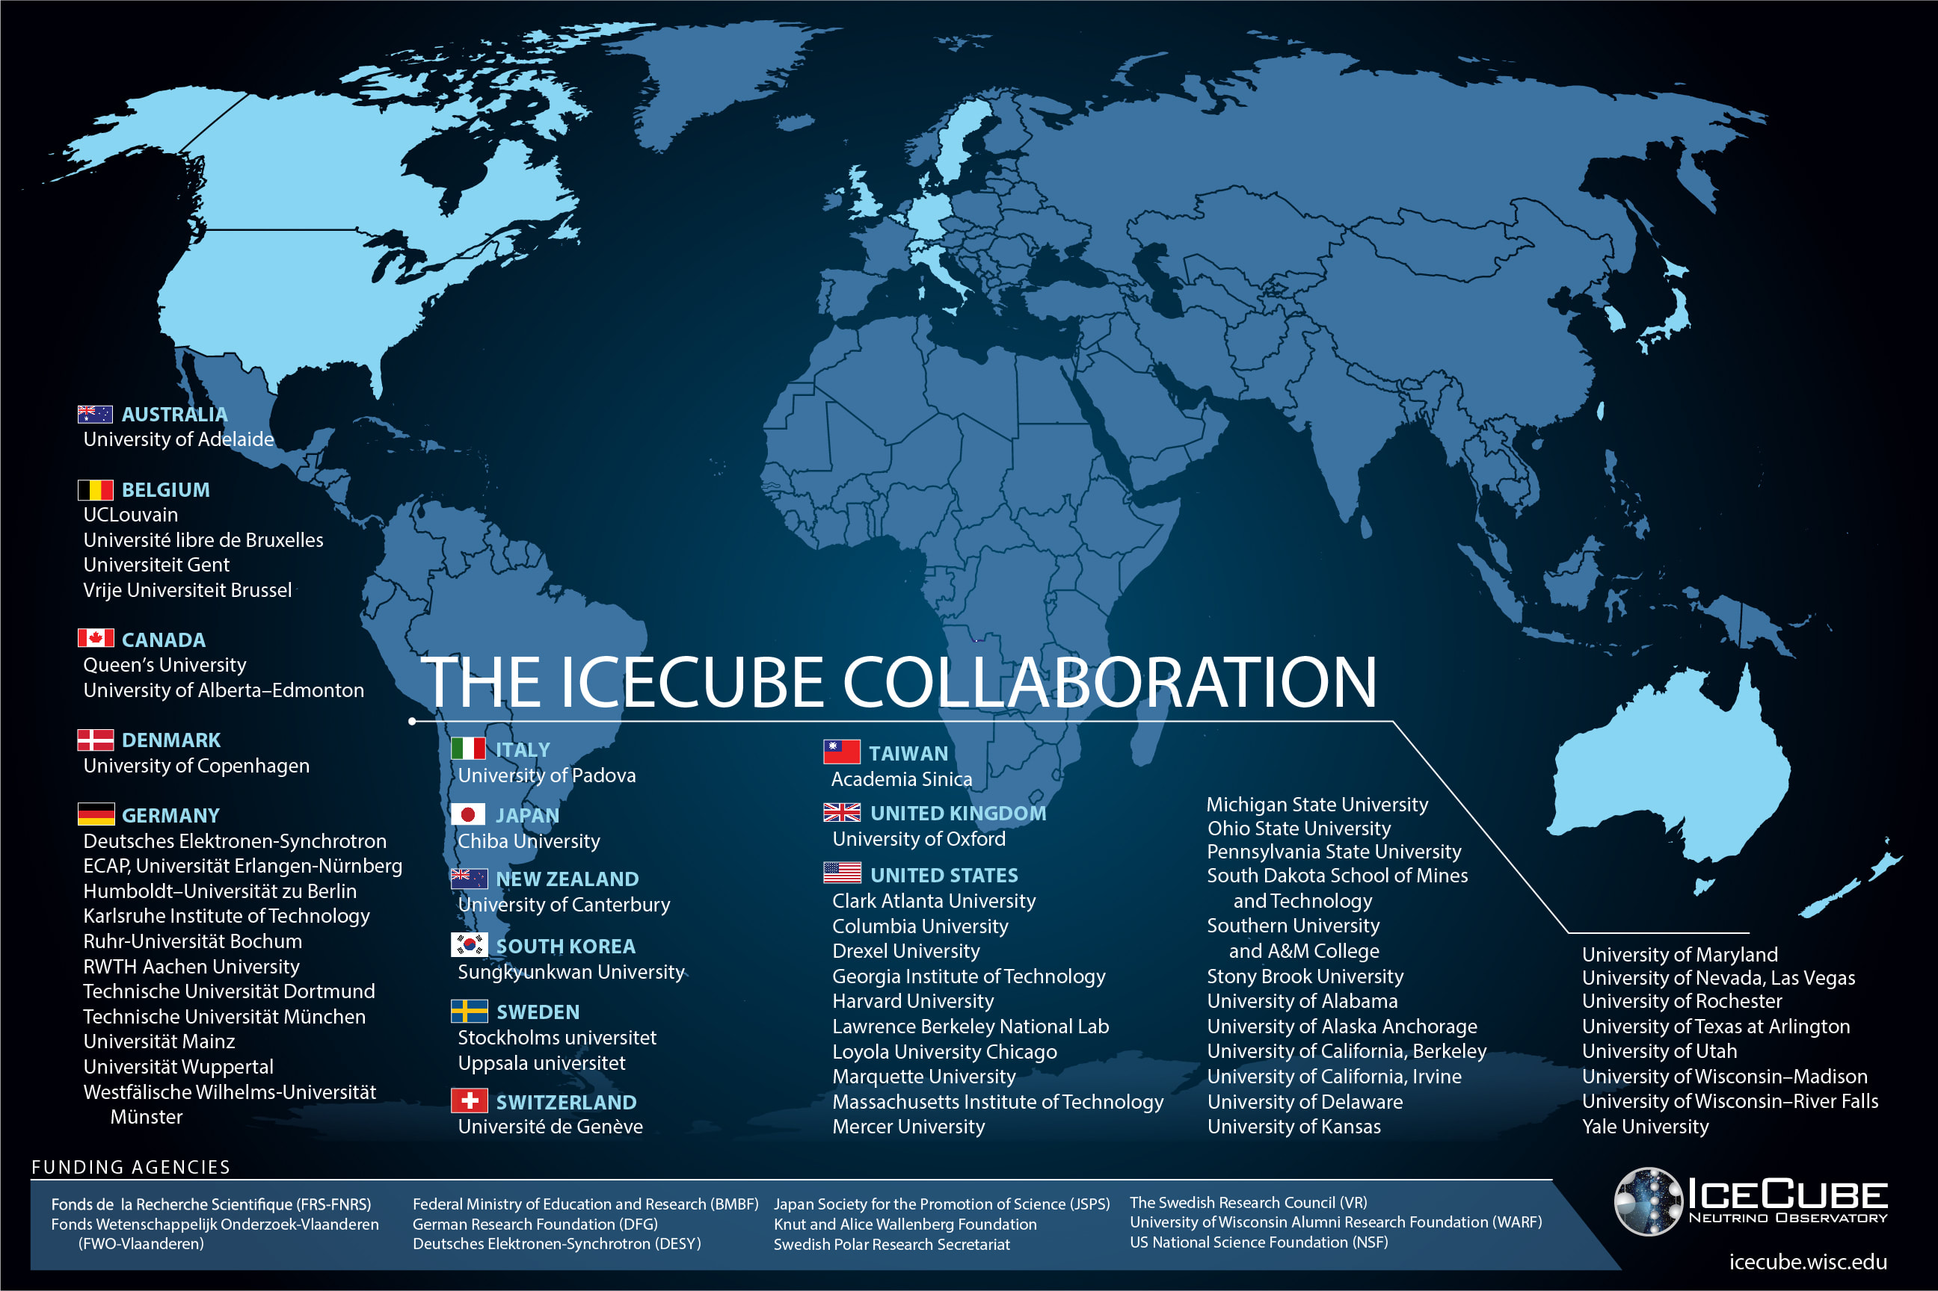

Slide 3
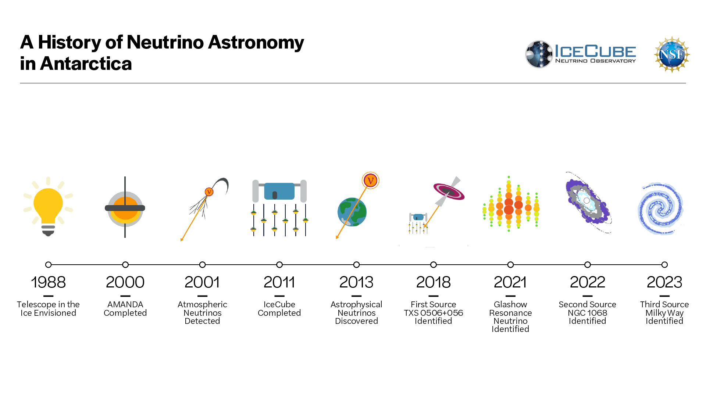
3

Slide 4
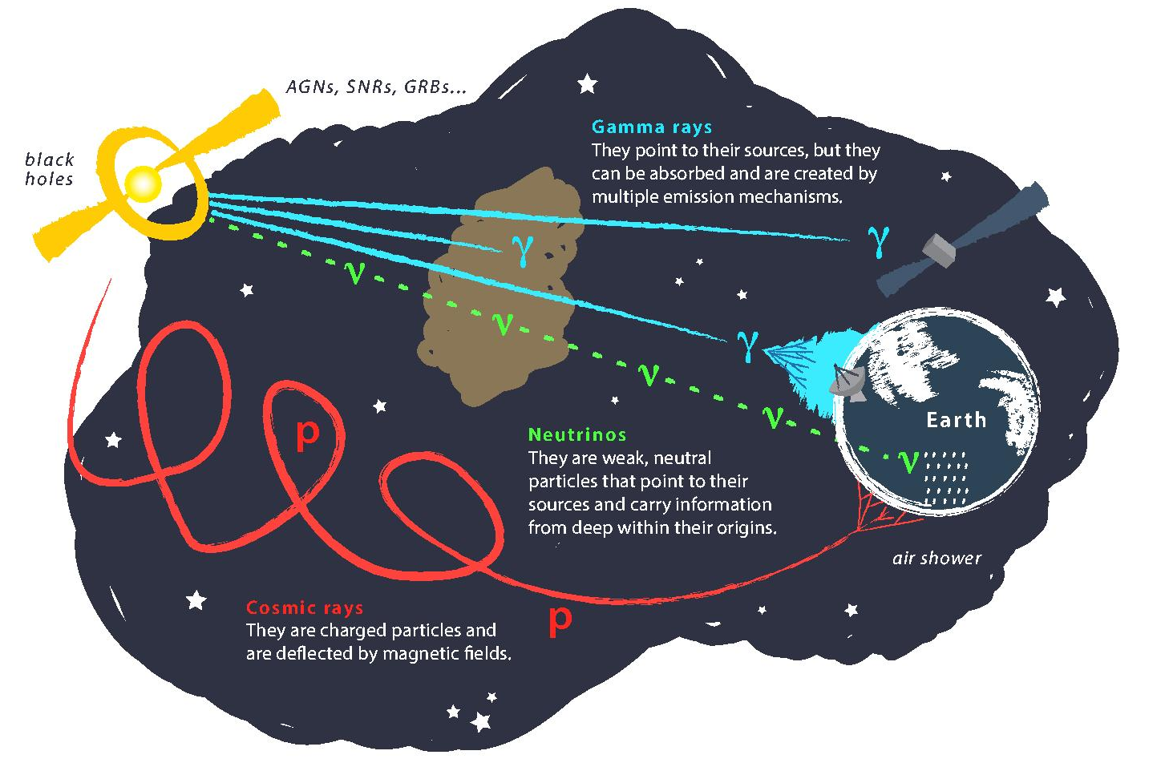
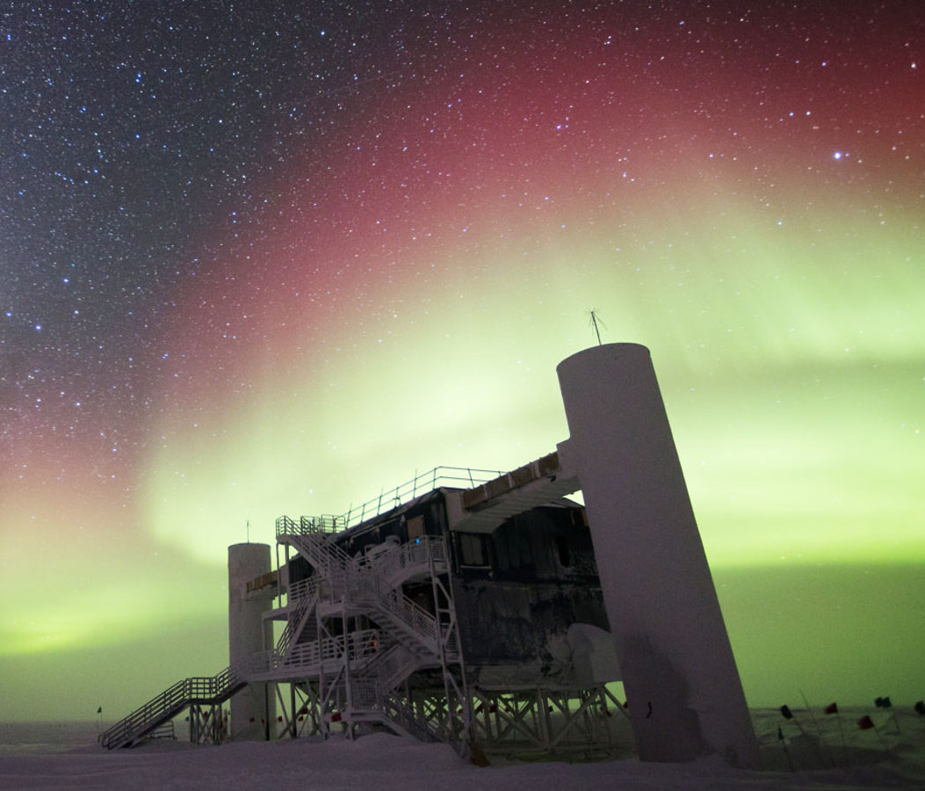
Astroparticle Physics
gallery.icecube.wisc.edu
Credit: IceCube / NSF

Slide 5
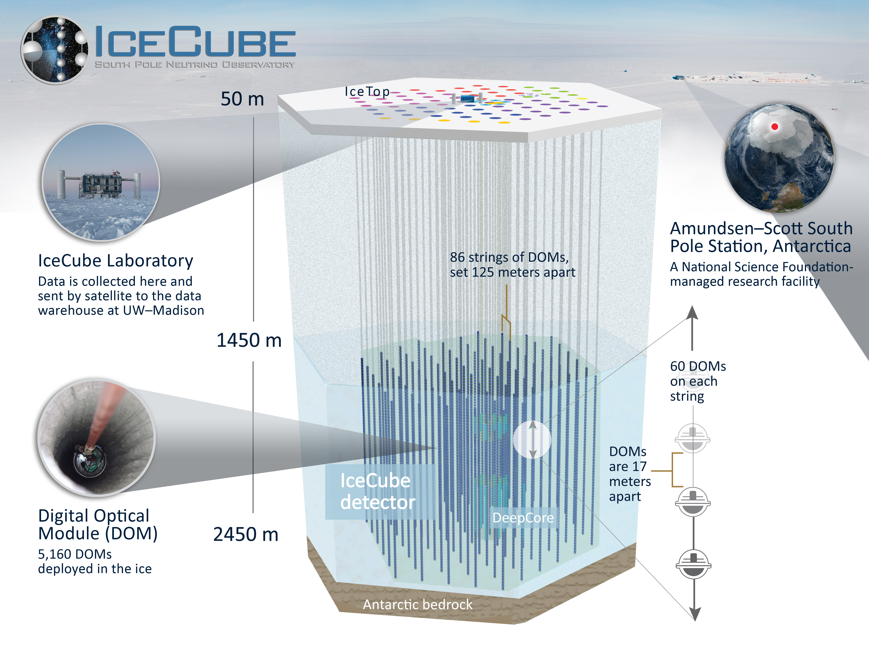
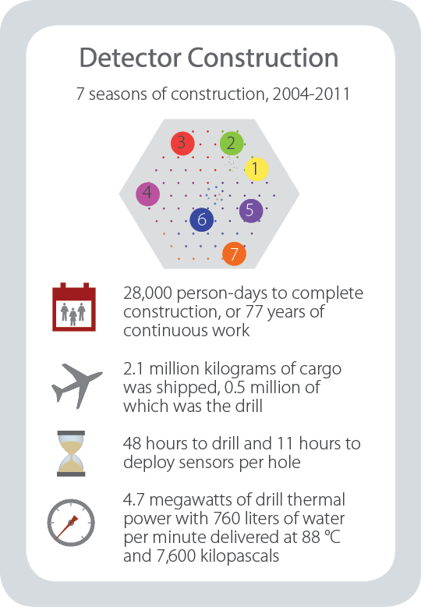
gallery.icecube.wisc.edu

Slide 6
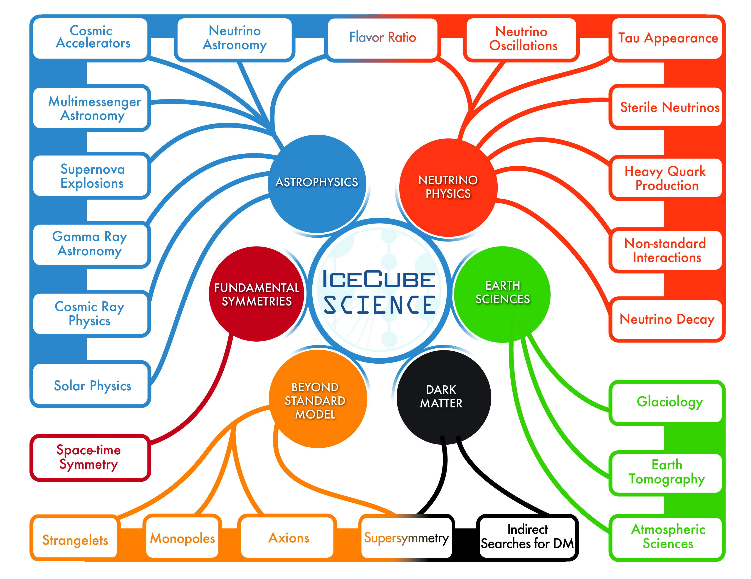
gallery.icecube.wisc.edu

Slide 7
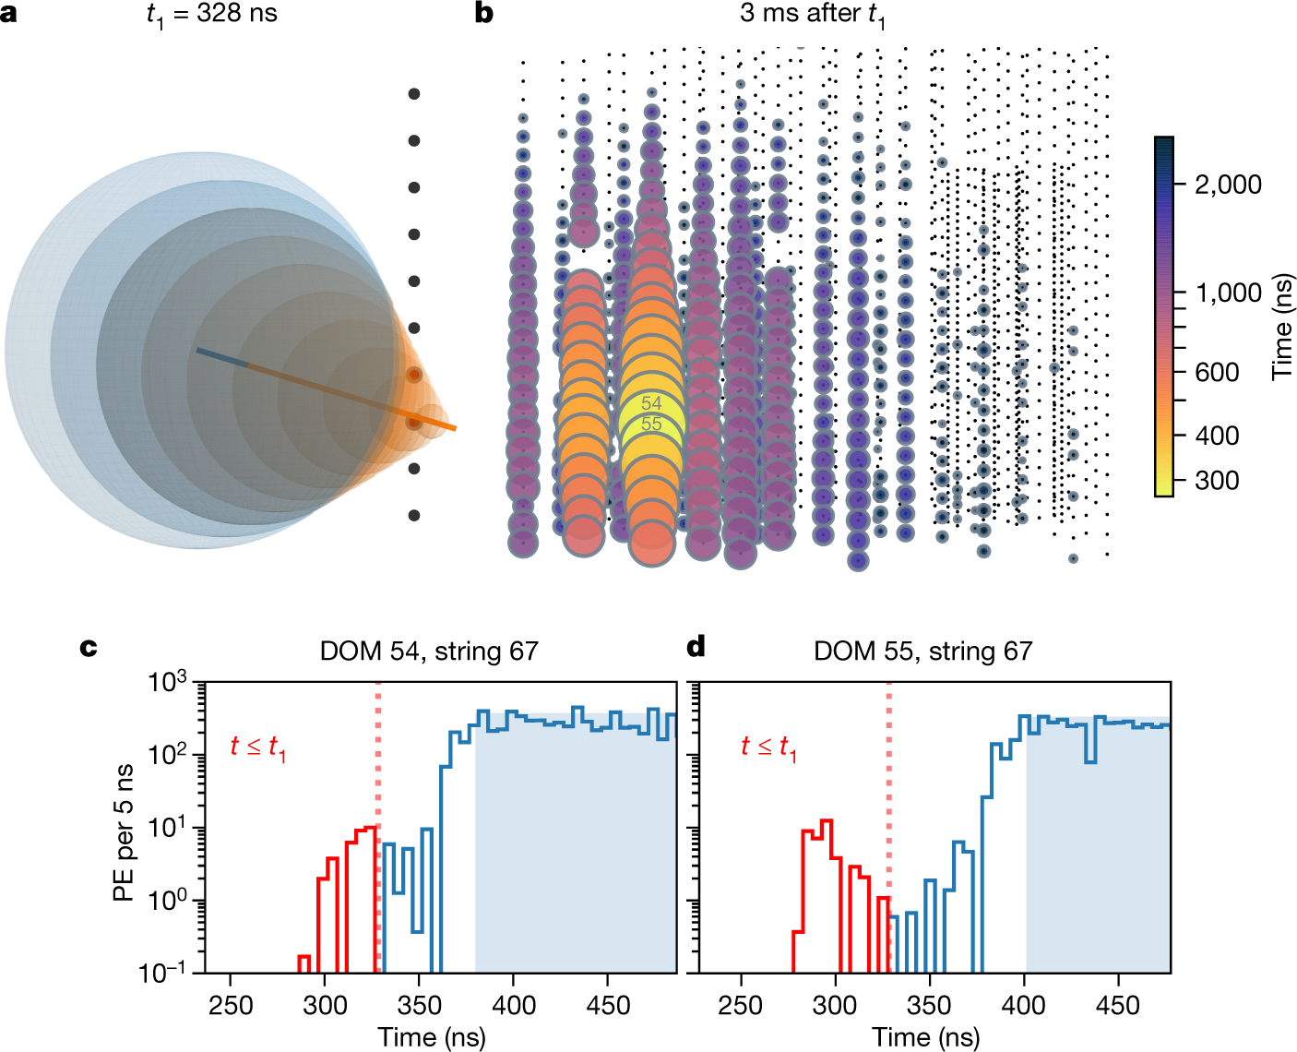
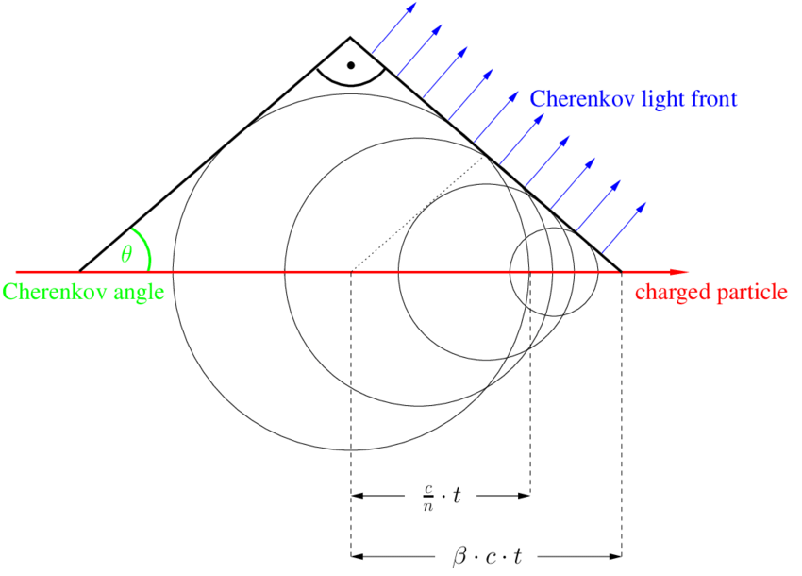
Particle Detection – Cherenkov Light
10.1038/s41586-021-03256-1
T. Gluesenkamp

Slide 8
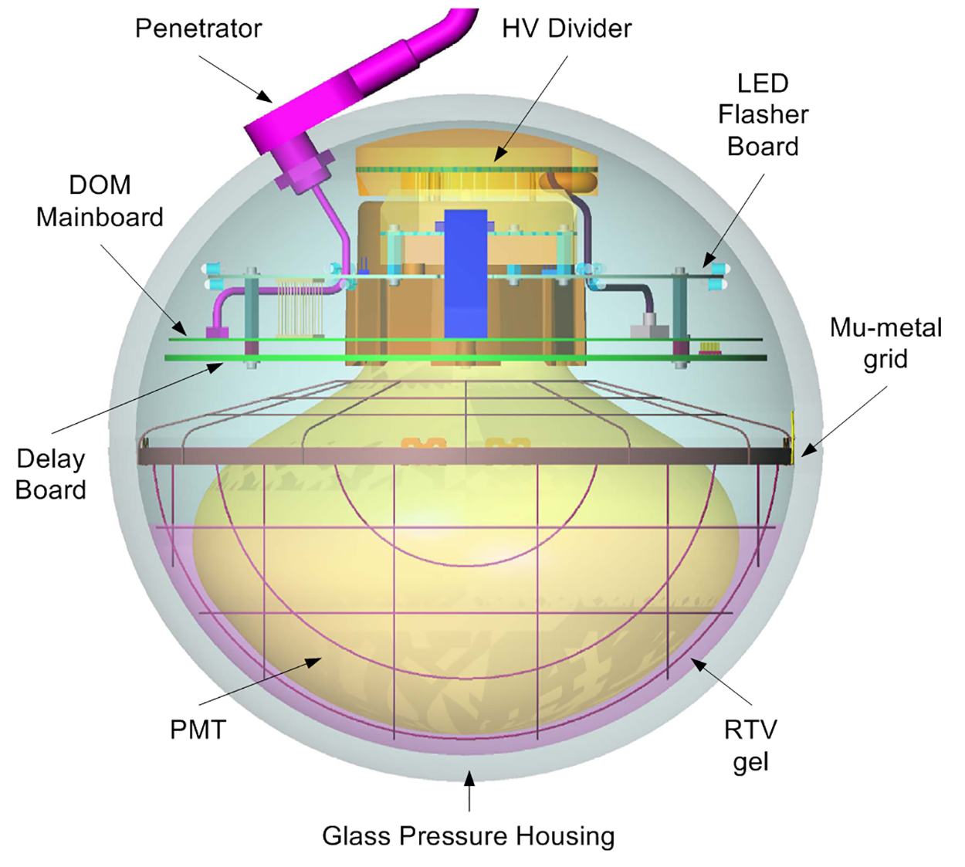
Digital Optical Module (DOM)
icecube.wisc.edu

Slide 9
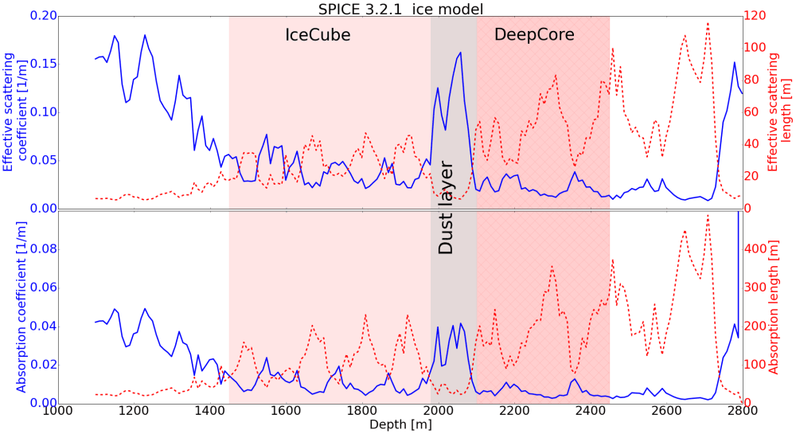
Detection Medium - Ice
icecube..wisc.edu

Slide 10
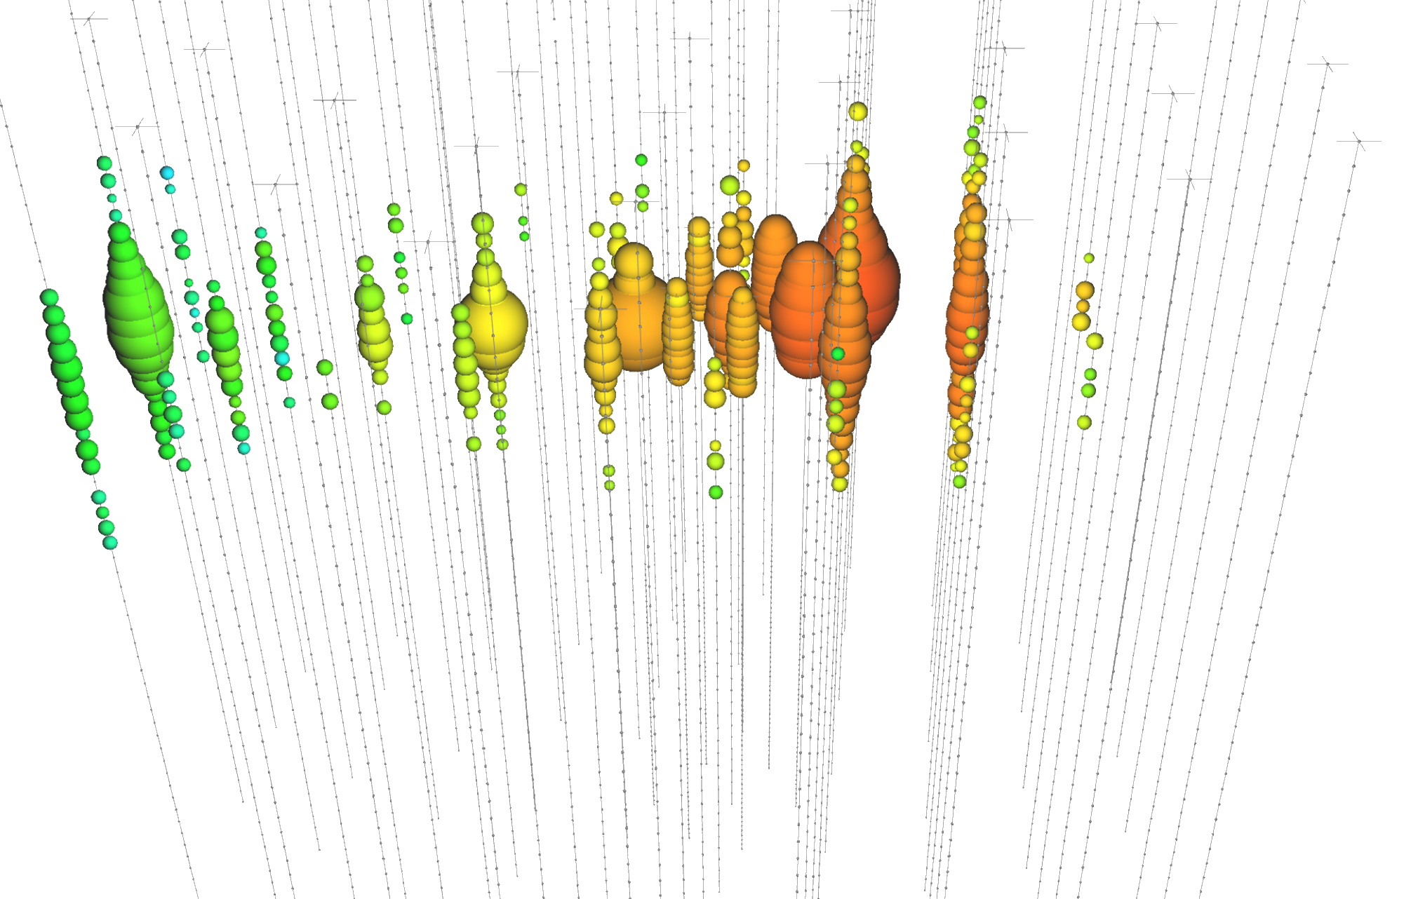
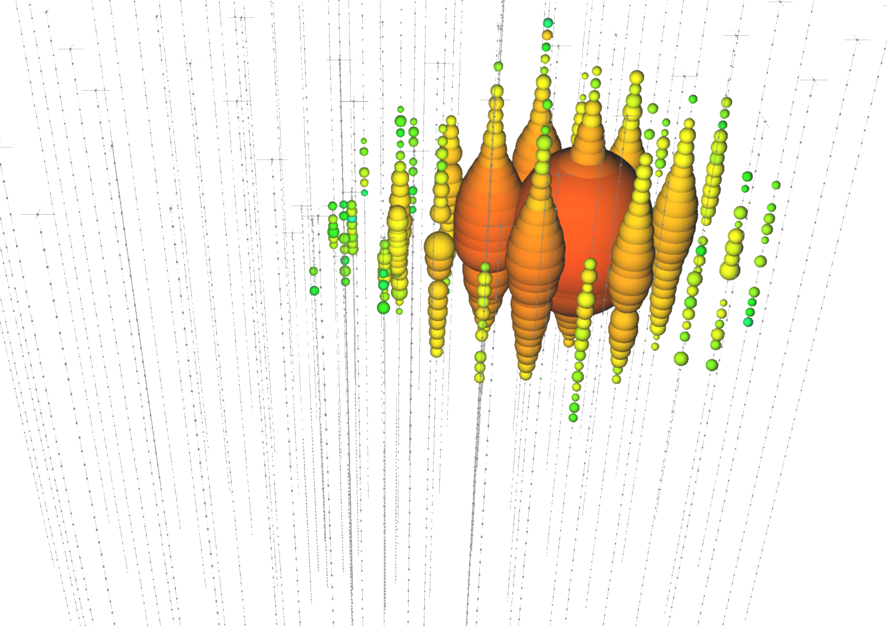
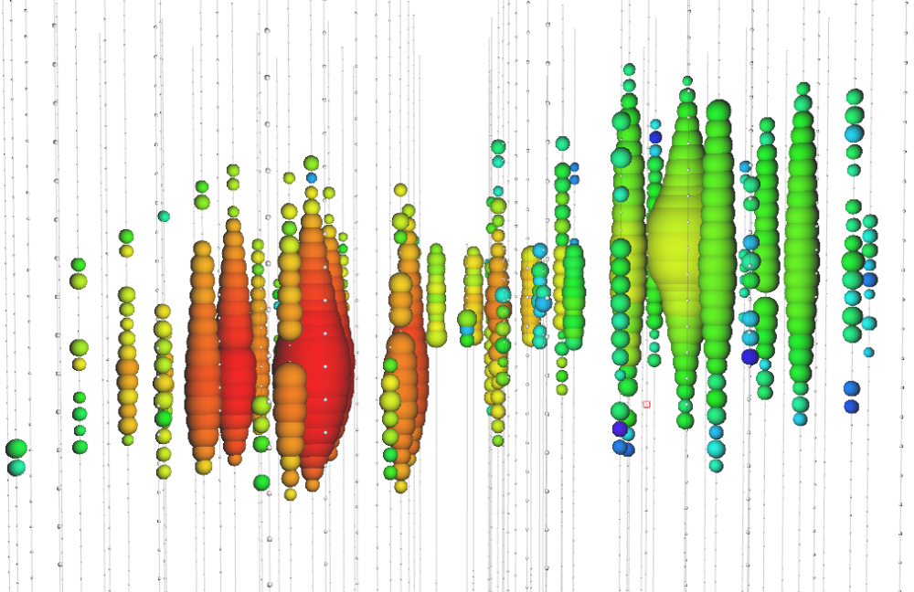
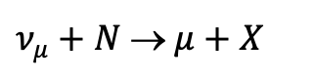
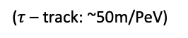
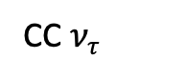
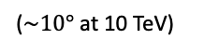
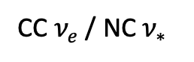
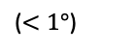
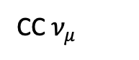
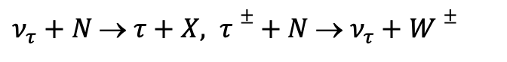
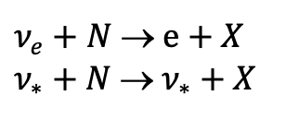
Event Topologies
CC $ν_{μ}$
CC $ν_{e}$ / NC $ν_{∗}$
CC $ν_{τ}$
icecube.wisc.edu
$ν_{μ}+N$ → $μ+X$
$ν_{e}+N$ → $e+X$
$ν_{∗}+N$ → $ν_{∗}+X$
$ν_{τ}+N$ → $τ+X, τ±+ N$ → $ν_{τ}+W±$
Track
Cascade
Cascade / Track / Double-Cascade
($<1°$)
($\sim 10°$ at 10 TeV)
($τ$ – track: ~50m/PeV)

Slide 11

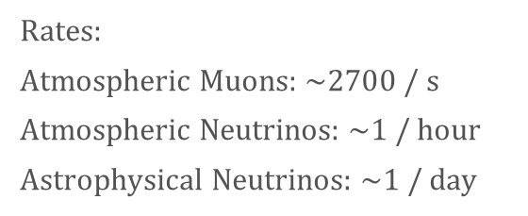

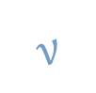


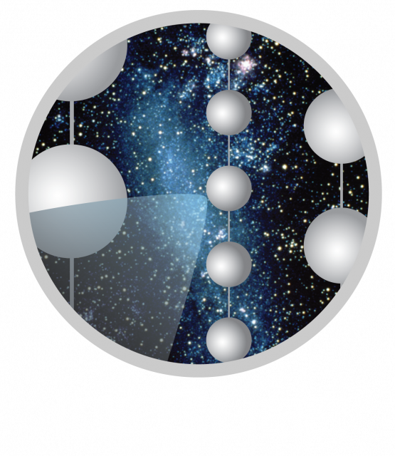
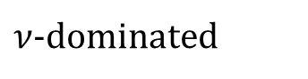

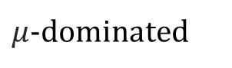
Air Shower
Astrophysical Source
Atmosphere
(not to scale)
Air shower
Air shower

Slide 12
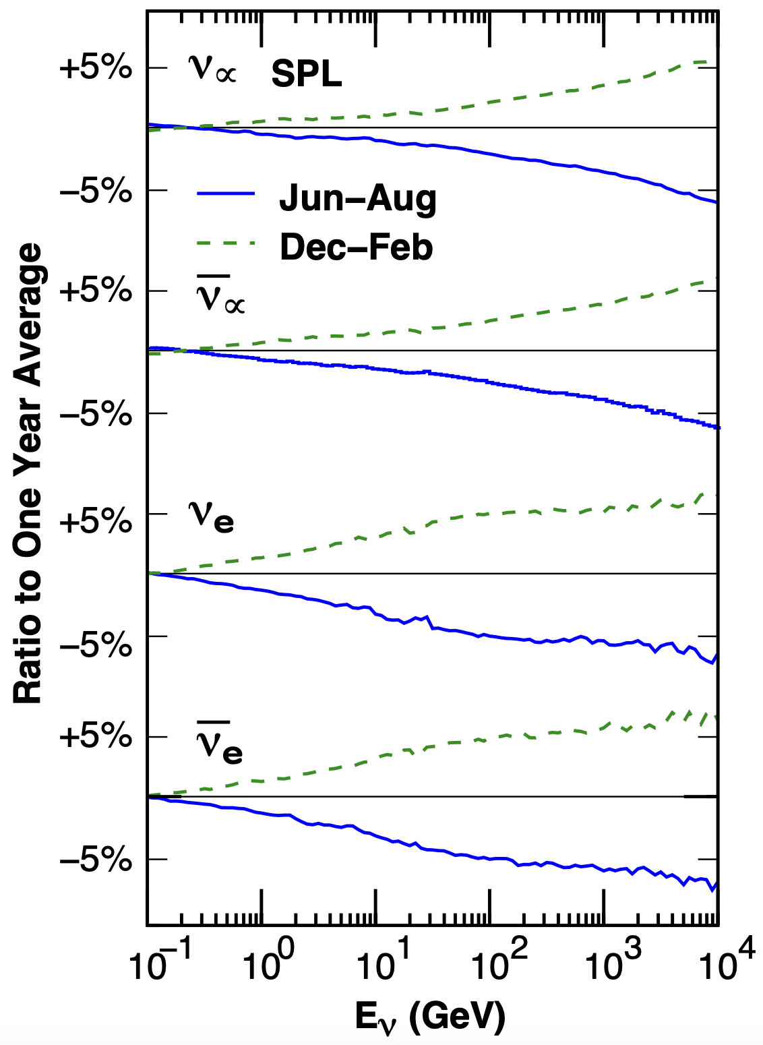
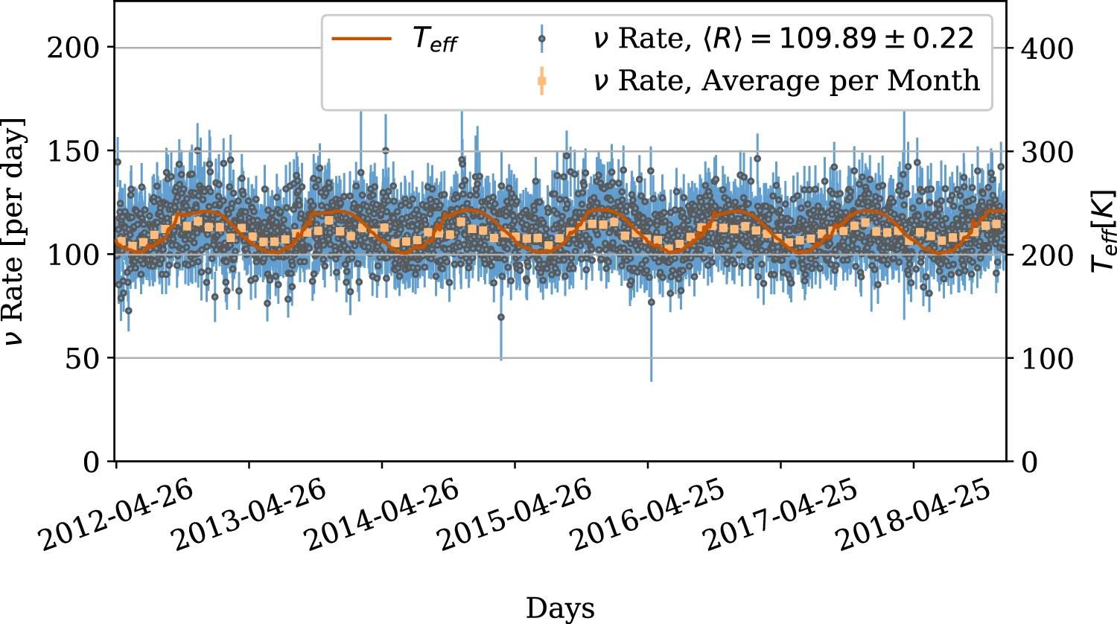
Seasonal Variations of Atmospheric Neutrinos
10.1140/epjc/s10052-023-11679-5
10.1103/PhysRevD.92.023004

Slide 13
Muon Deflections
10.22323/1.444.1197
10.1140/epjc/s10052-022-11102-5

Slide 14
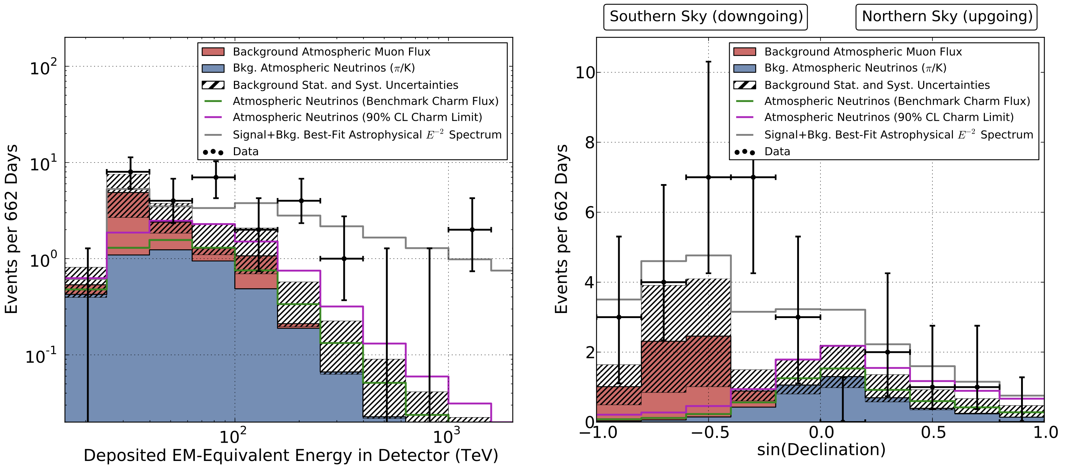
Astrophysical Neutrinos Discovered
10.1126/science.1242856

Slide 15
Blazar
explain basics of AGN – blazar
also relevant for NGC?!
Where shall I put this slide?

Slide 16
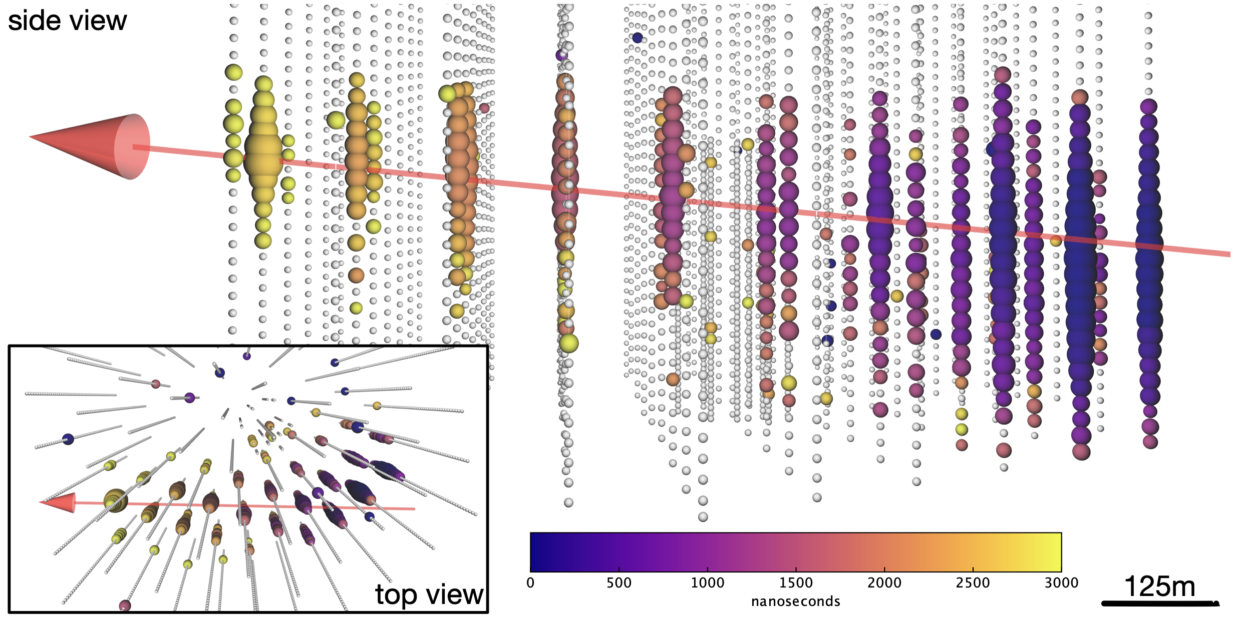
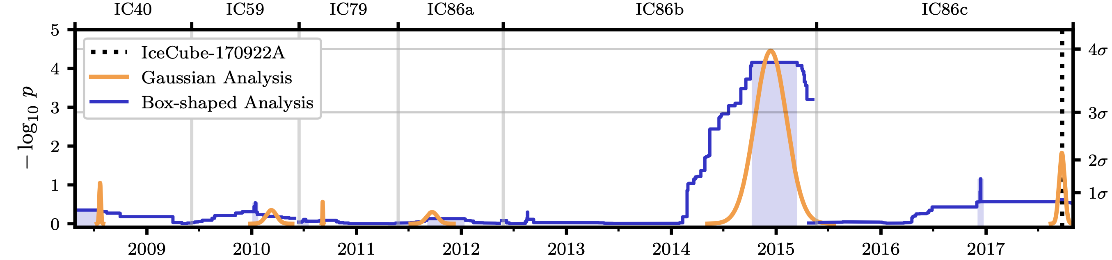
First Source TXS 0506+056 Identified
10.1126/science.aat1378
10.1126/science.aat2890

Slide 17
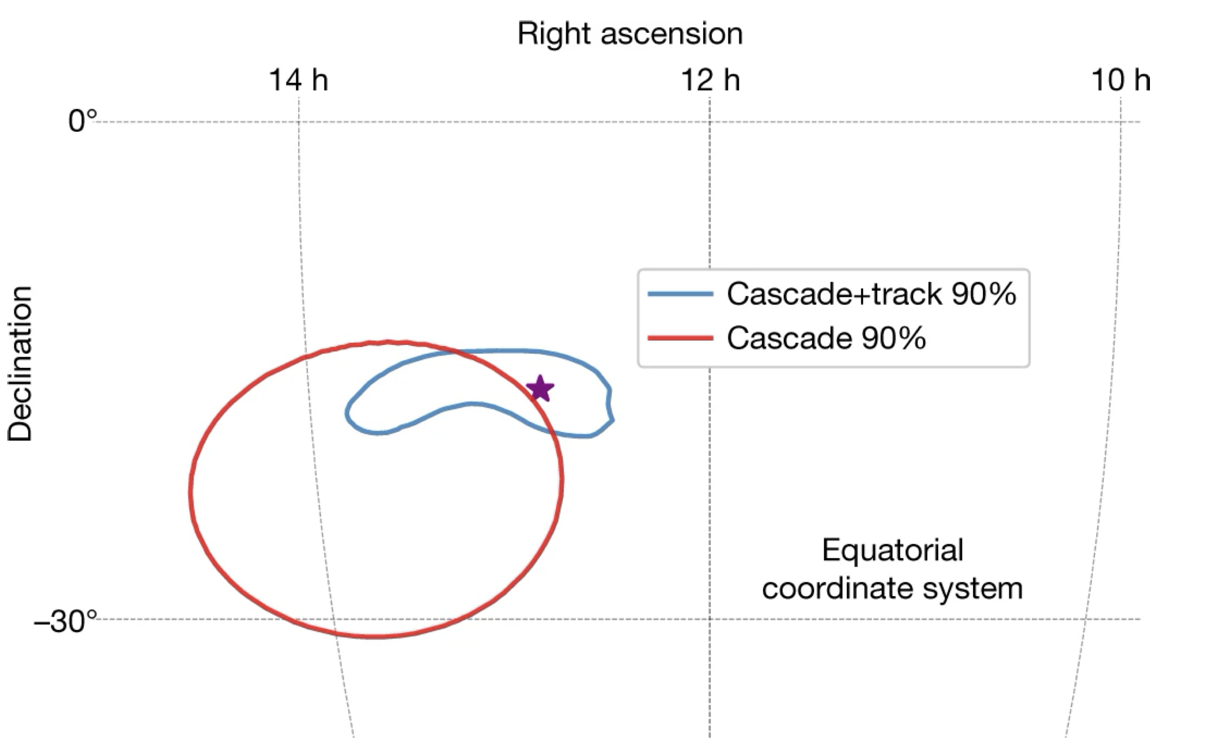
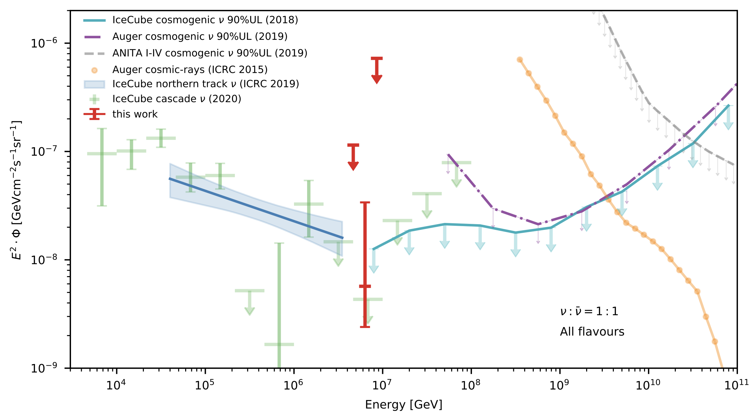
Glashow Resonance Neutrino Identified
10.1038/s41586-021-03256-1

Slide 18
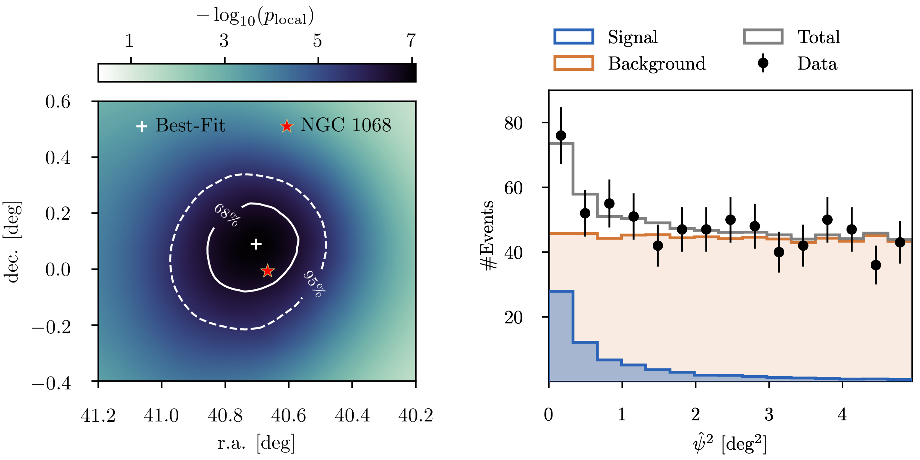
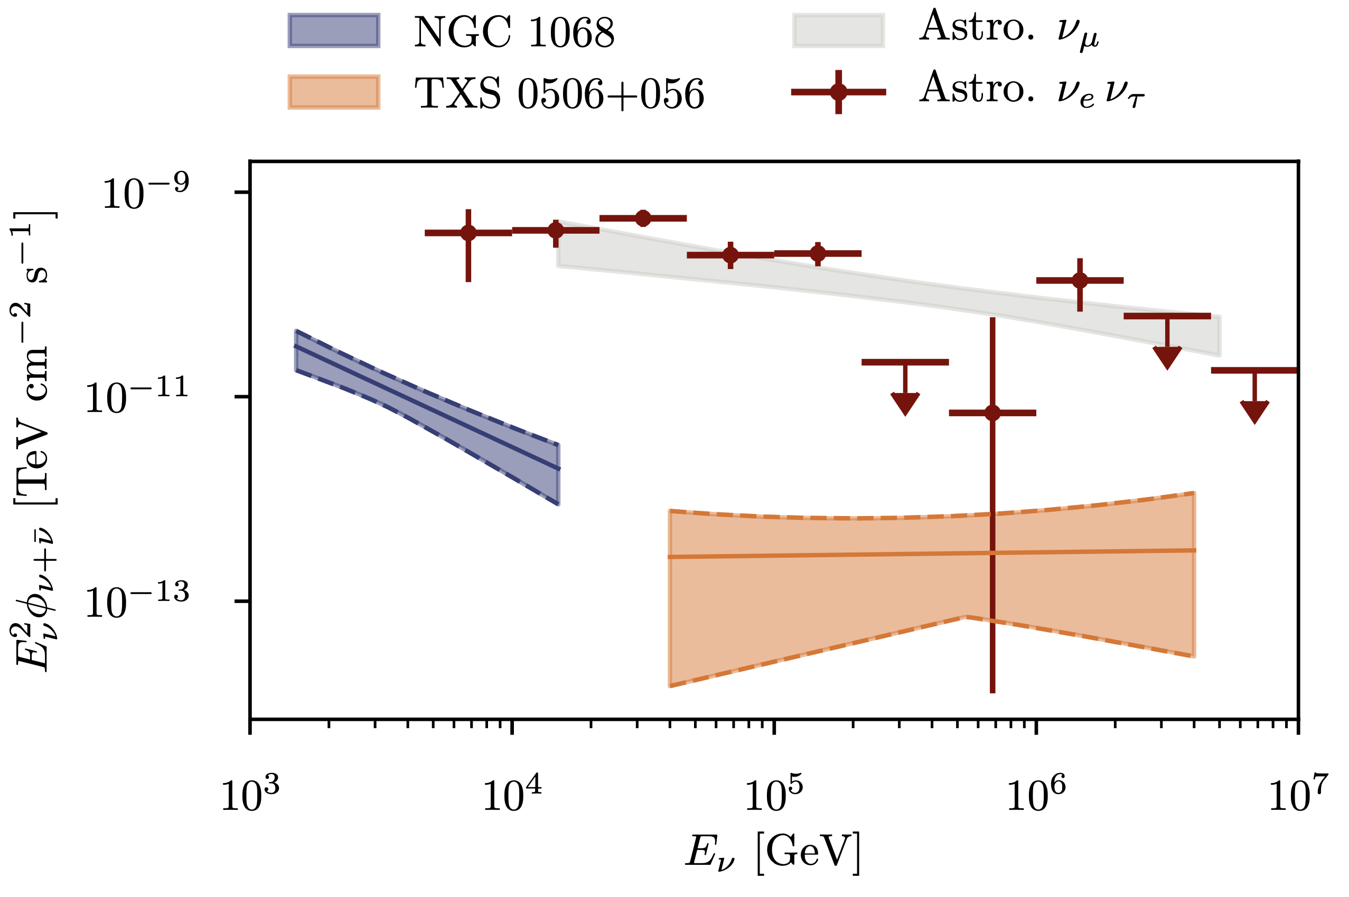
Second Source NGC 1068 Identified
10.1126/science.abg3395

Slide 19
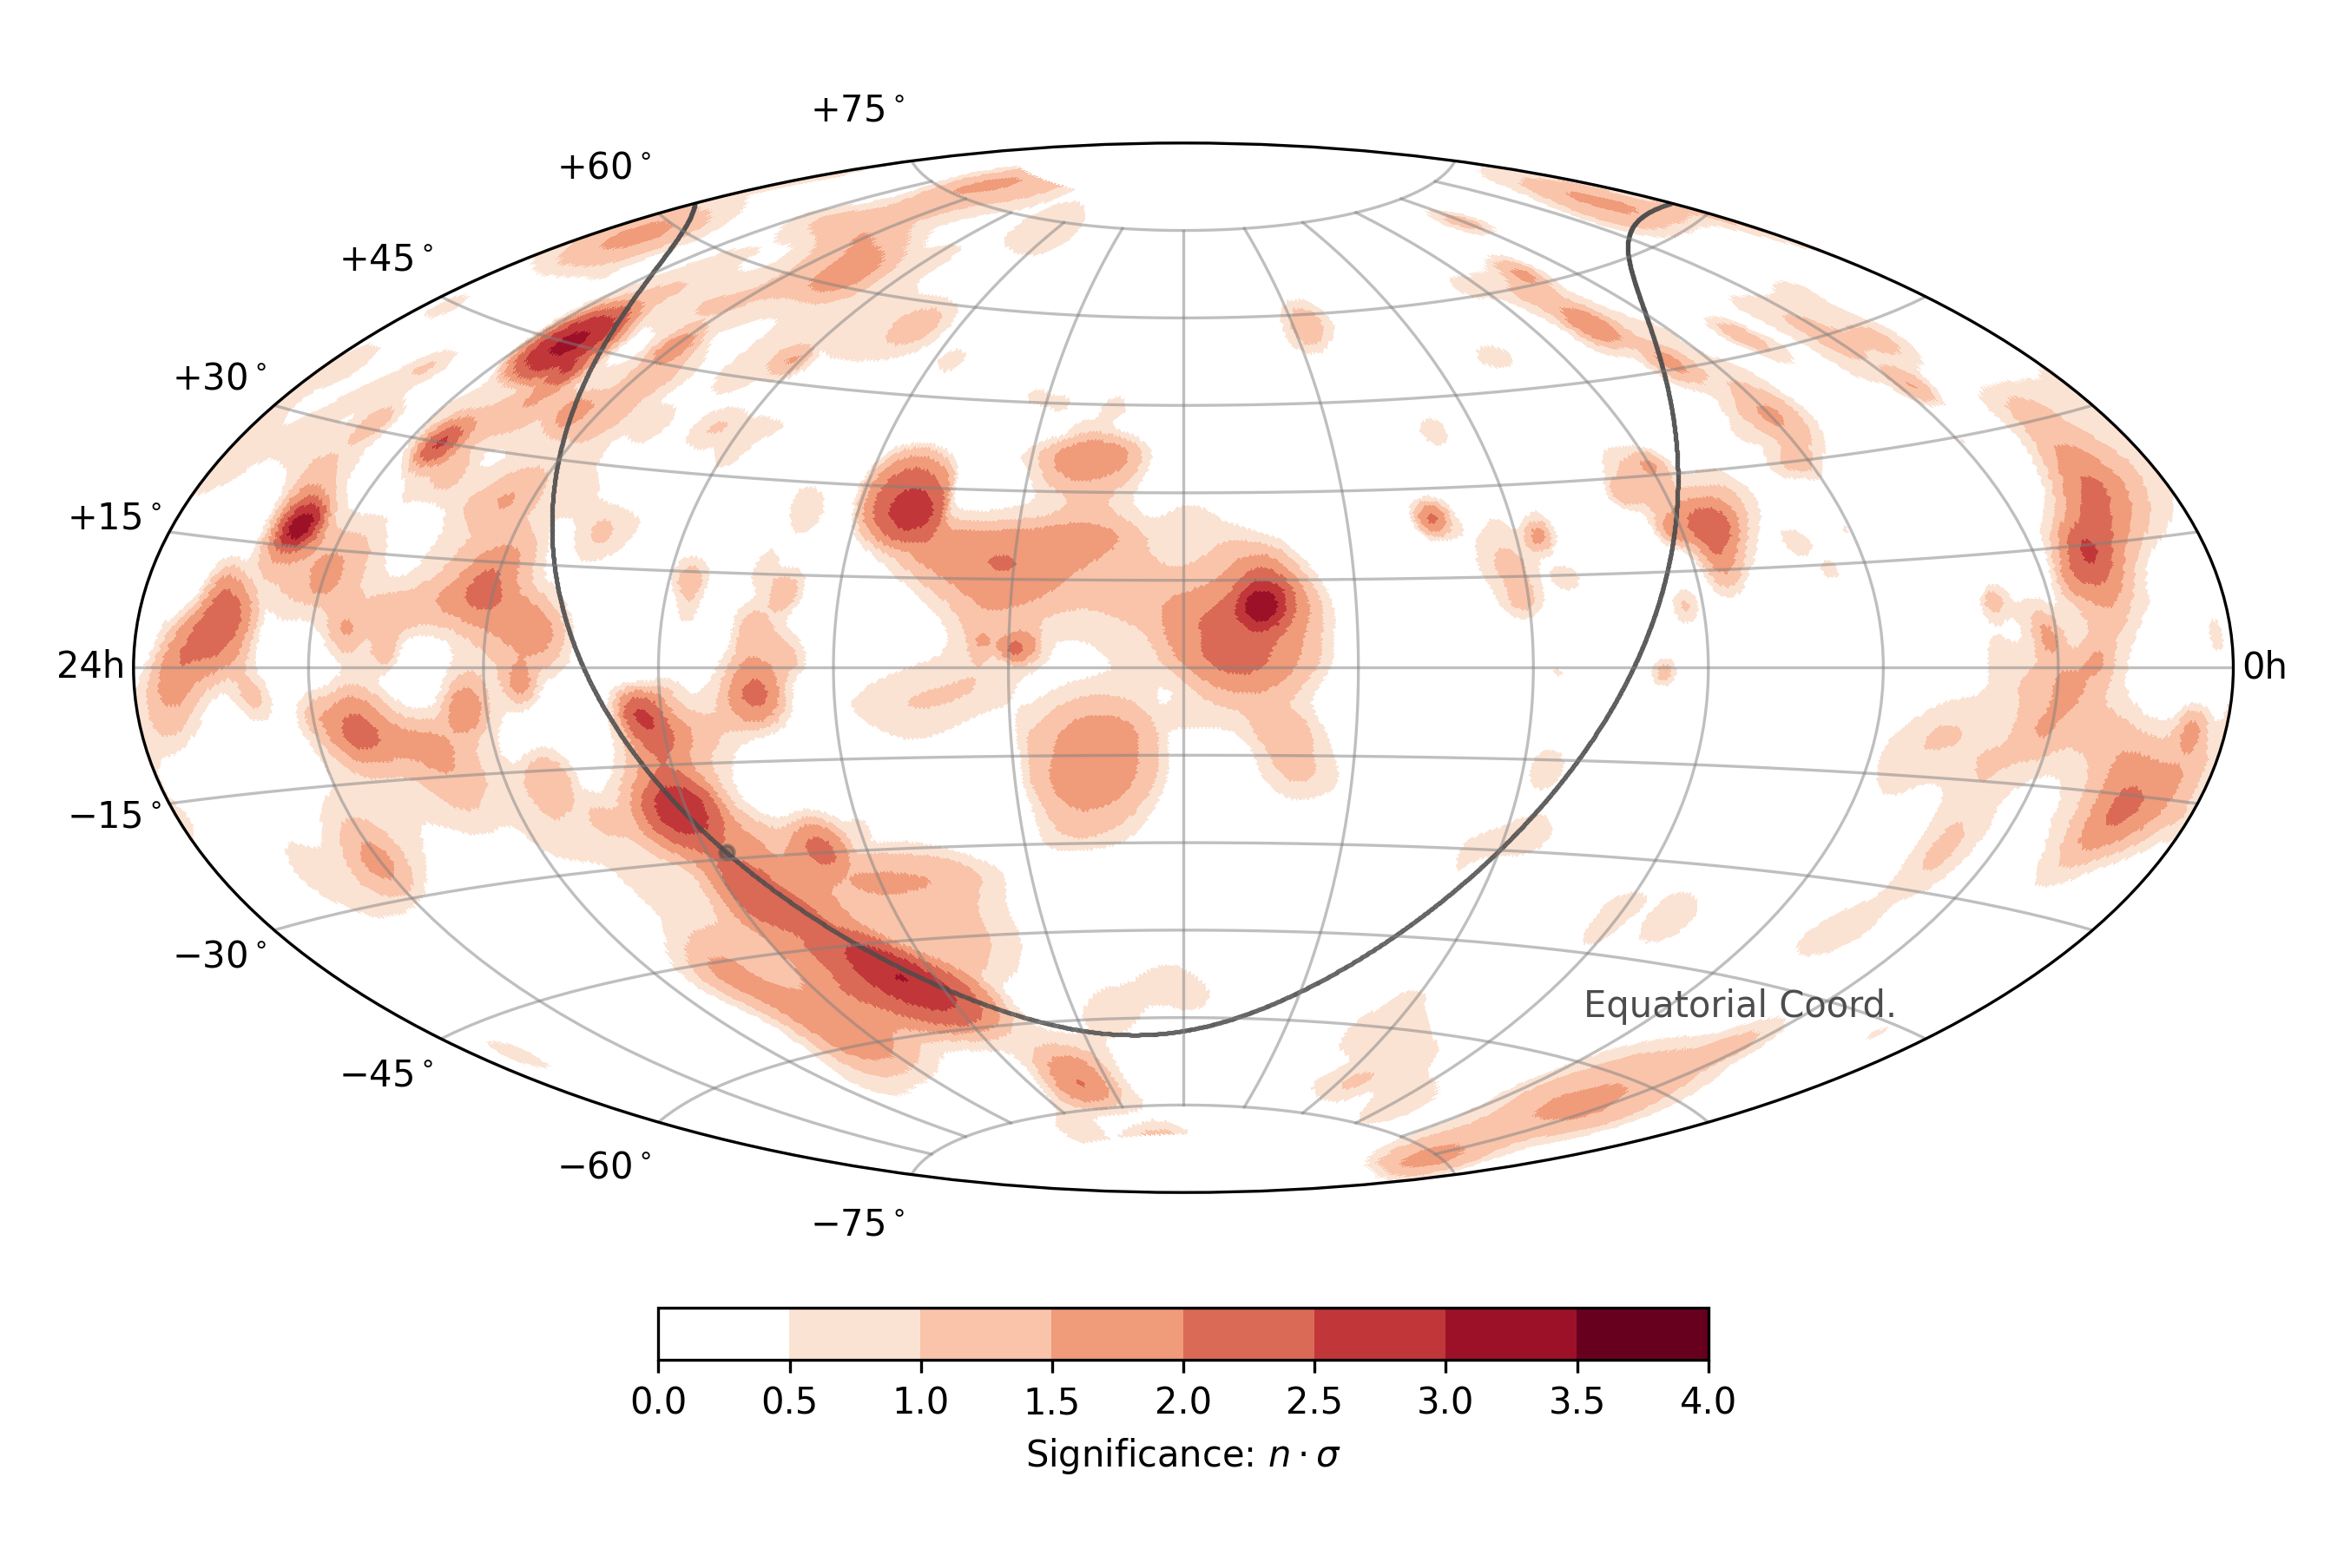
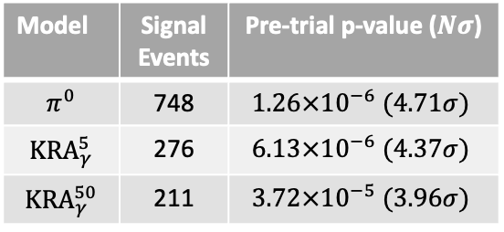

Third Source Milky Way Identified
After trial-correction: $4.5σ$
Model | Signal Events | Pre-trial p-value ($Nσ$)
$$π^{0}$$ | 748 | $$1.26×{10}^{−6} (4.71σ)$$
$${KRA}_{γ}^{5}$$ | 276 | $$6.13×{10}^{−6} (4.37σ)$$
$${KRA}_{γ}^{50}$$ | 211 | $$3.72×{10}^{−5} (3.96σ)$$
$π^{0}$: based on Fermi-LAT gamma-ray measurements (DOI: 10.1088/0004-637X/750/1/3)
${KRA}_{γ}^{5/50}$: based on Gaggero et. al (DOI 10.1088/2041-8205/815/2/L25)
10.1126/science.adc9818

Slide 20
The Muon Puzzle

Slide 21
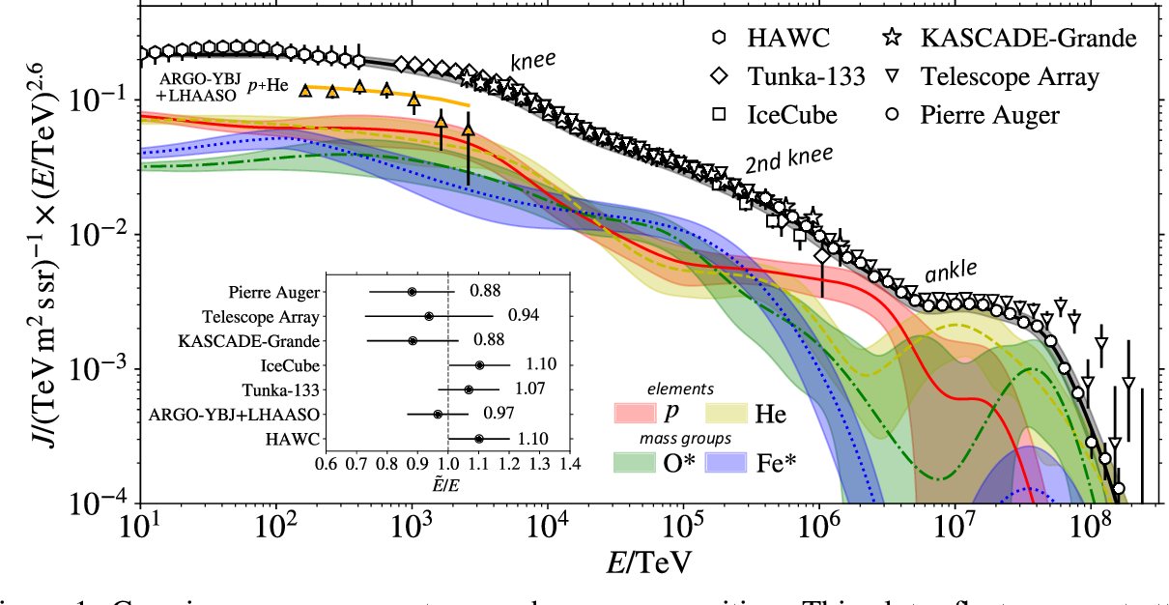
Cosmic Ray Flux
1903.07713

Slide 22
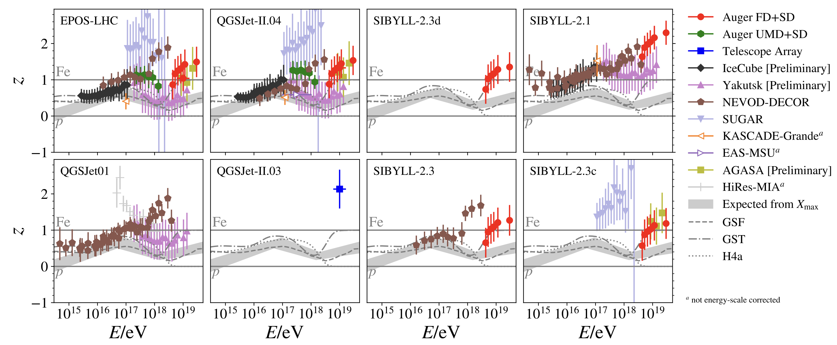
The Muon Puzzle
what is z?
2108.08341

Slide 23
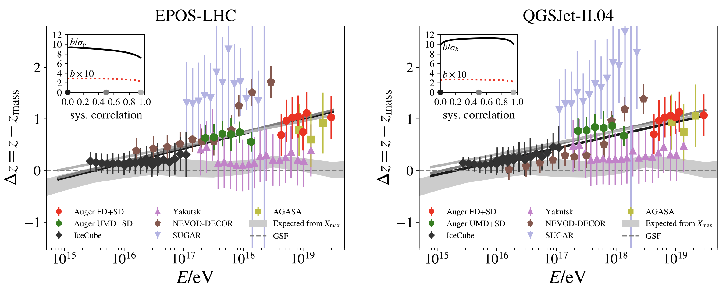
what does delta z mean?
2108.08341

Slide 24
Connection to LHC

Slide 25
possible solutions

Slide 26
prompt muons

Slide 27
!! Check icecube’s homepage, there are some quick facts and stuff like that

Slide 28
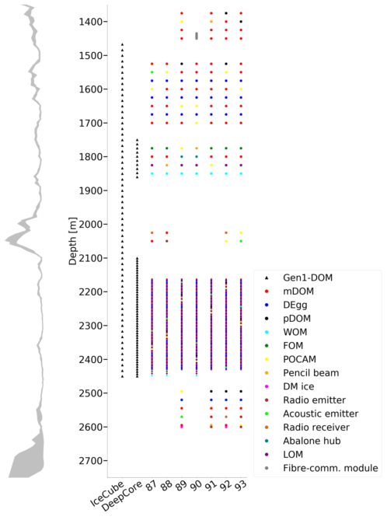
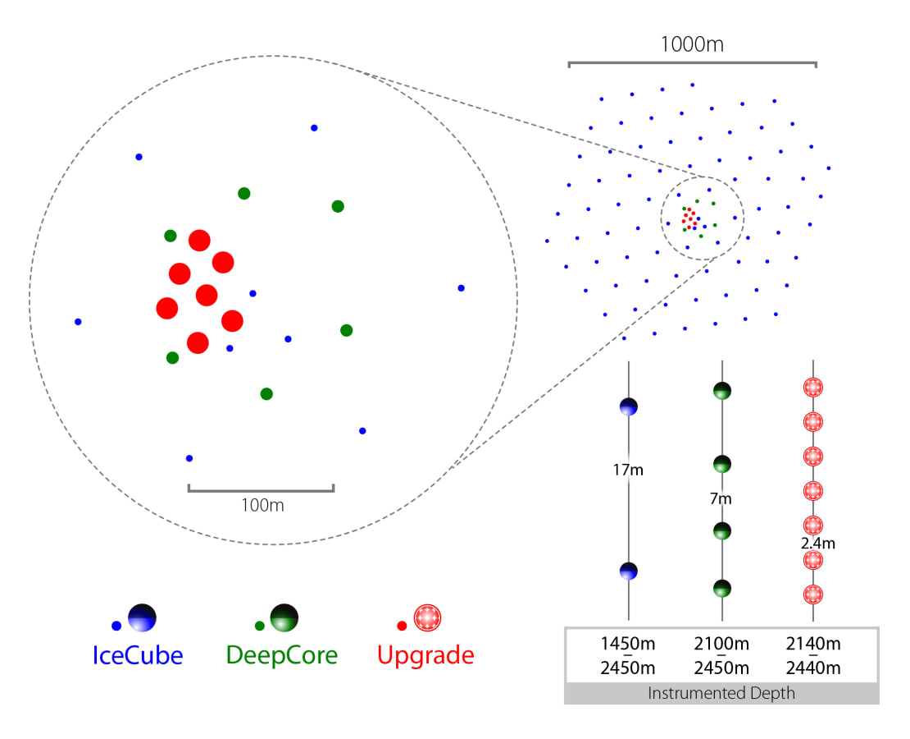
IceCube Upgrade
nbi.ku.dk
icecube.wisc.edu

Slide 29

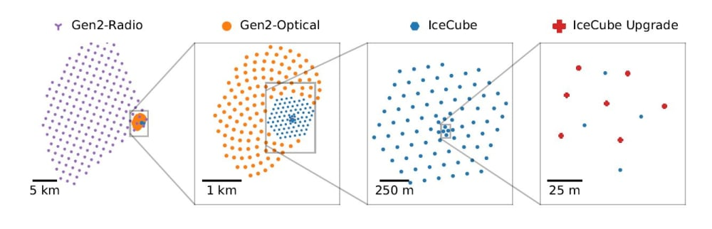
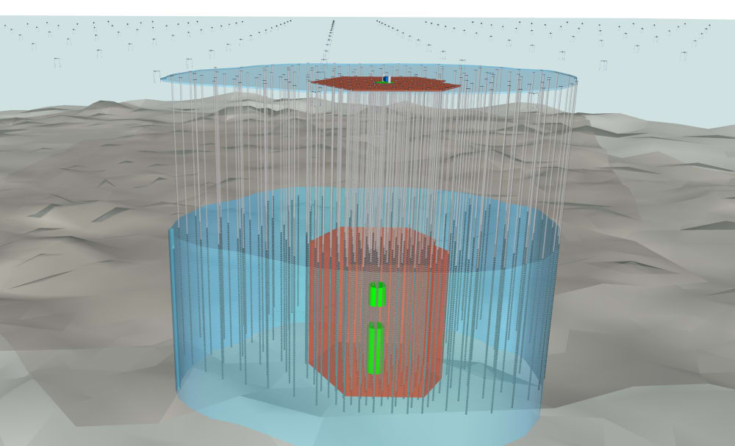
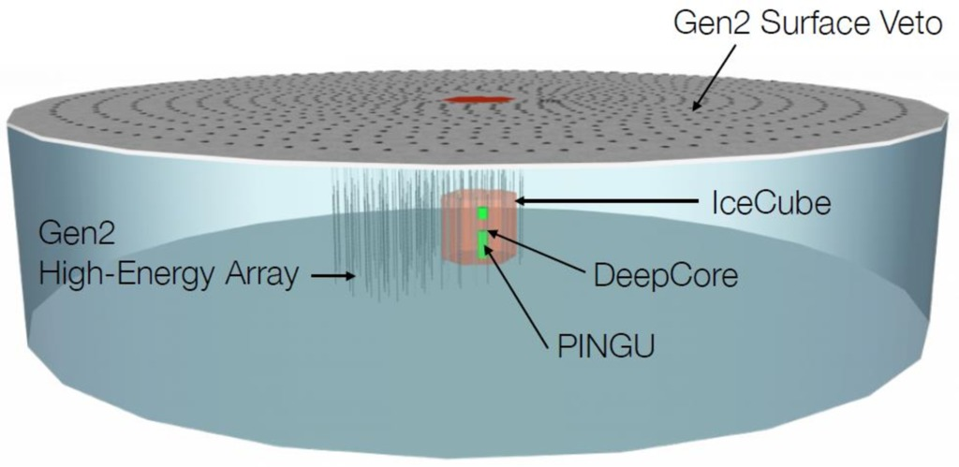
IceCube Gen-2
icecube.wisc.edu

Slide 30
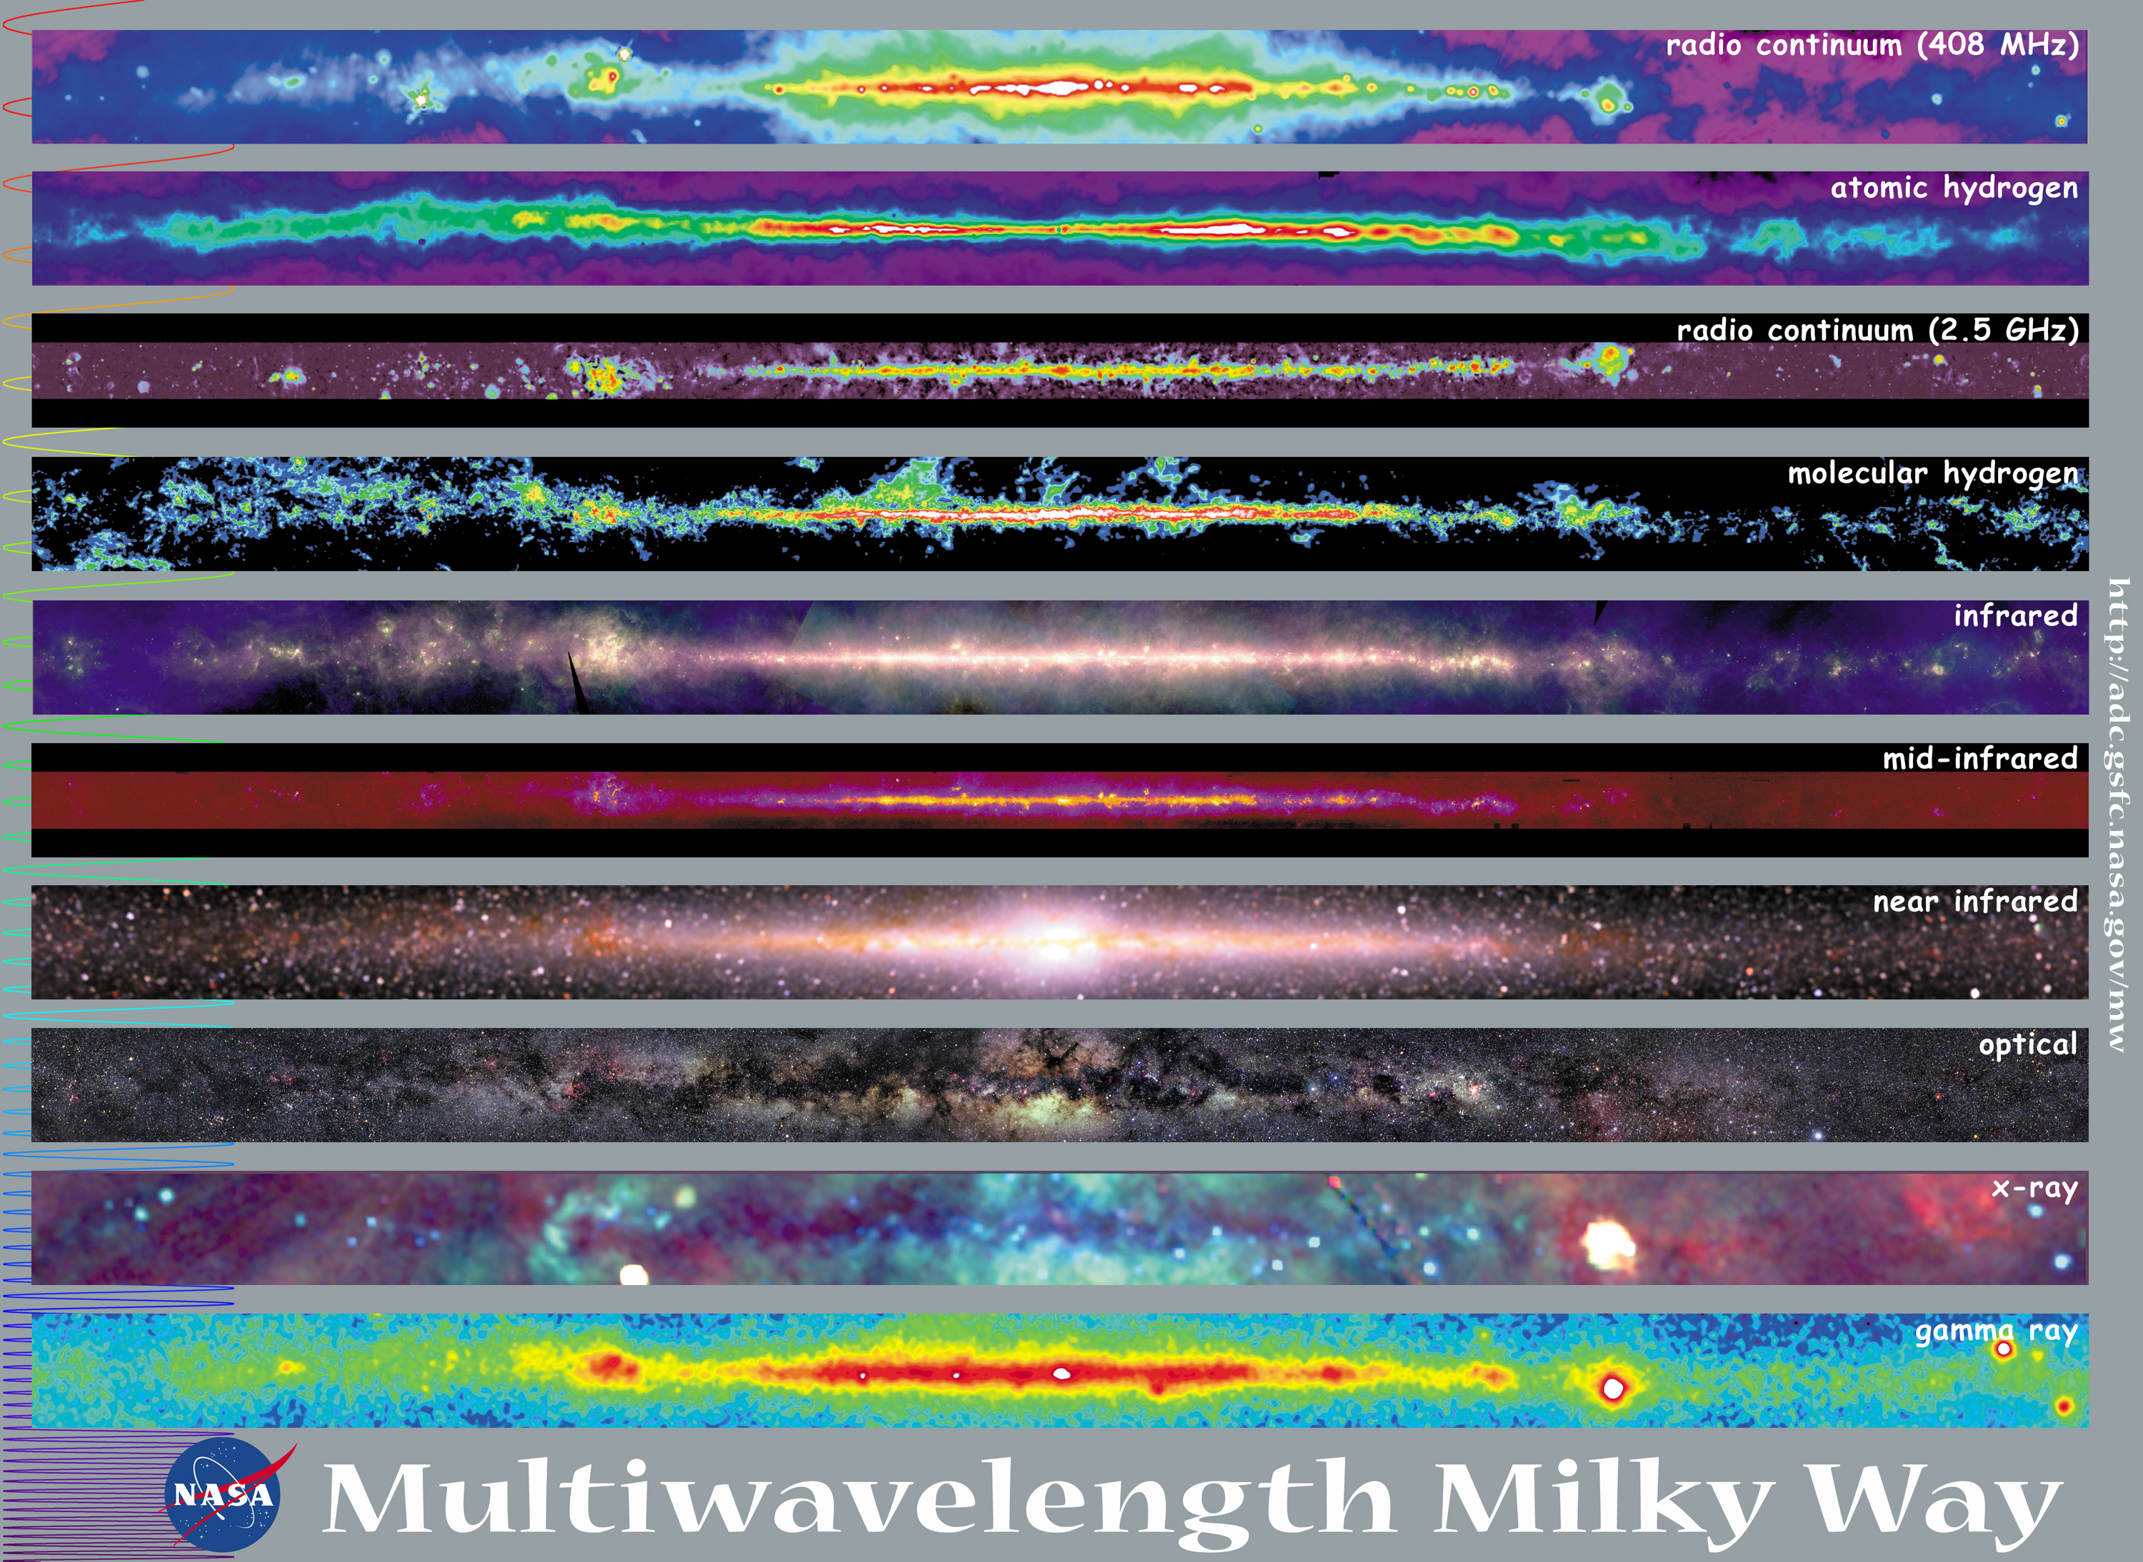
Multiwavelength Milky Way

Slide 31
Multiwavelength Multimessenger Milky Way
neutrinos

Slide 32
Radio Neutrino Astronomy

